Slide 1







Software Testing Project
Manual Testing • Automation Testing • API Testing
Manual Testing
Automation & API Testing
Application under test
Application under test
magento2demo.firebearstudio.com
practice.expandtesting.com
Team Members
Supervisor
Dr. Mahmoud Maher Raslan
• Mahmoud Mohamed Mahmoud Abdel Samad (Team Leader)
• Abdelrahman Mohamed Islam
• Islam Ahmed Abdel Aal Ahmed
• Yehia Samy Mohamed Hamed
• Sarah Medhat Abdelaief
• Mahmoud Mohamed Mahmoud Aleem
Course
Software Testing

Slide 2








Introduction
PROJECT OVERVIEW This project evaluates web applications through Manual, Automation, and API Testing to ensure quality, functionality, and reliability.
Why These Websites?
Testing Types
• Magento 2 Demo — chosen for Manual Testing for its realistic e-commerce environment.
• Expand Testing — used for Automation & API Testing after technical limits on the first site.
Manual Testing
Automation Testing
API Testing
Tools Used
Expected Outcomes
• Ensure the application is stable and ready for release.
• Identify and report software defects.
• Verify critical features.
• Improve overall software quality.
Microsoft Excel
Selenium
Postman

Slide 3



Project Scope
Target Users
Manual Testing Scope
Automation Testing Scope
API Testing Scope
Magento 2 Demo
Expand Testing
Customers
Shoppers
QA Engineers
Software Testers
Developers
User Registration
User Login
Product Search
Product Details
Shopping Cart
Checkout Process
Wishlist
Contact Us
Forgot Password
User Authentication (Login)
Navigate to Contact Us Page
Forgot Password / Password Reset
Web Inputs Handling
Form Validation
Drag and Drop Actions
Secure Password Checker
User Registration
User Registration API
User Login API
Get User Profile API
Update User Profile API
Forgot Password API
Reset Password API
Create Note API

Slide 4

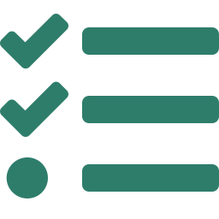
SDLC Model & Testing Strategy
SDLC Model
Testing Strategy
Waterfall Model
Manual Testing
Performed using Microsoft Excel to validate the application's functionality.
Requirements
Design
Implementation
Automation Testing
Testing
Implemented using Selenium WebDriver to automate key test scenarios.
Deployment
API Testing
Why Waterfall?
Conducted using Postman to validate API functionality, requests, and responses.
The project followed a clear, sequential testing process — making Waterfall well suited for planning, execution, and documentation.

Slide 5




Test Plan
Scope
Objectives
Test the core functionalities of the selected web applications through Manual Testing, Automation Testing, and API Testing.
Verify application functionality.
Identify and report software defects.
Ensure software quality and reliability.
Resources
Schedule
Microsoft Excel
1
Test Planning
Selenium WebDriver
2
Test Case Design
Postman
3
Test Execution
Google Chrome
4
Bug Reporting
Windows 11
5
Final Review

Slide 6
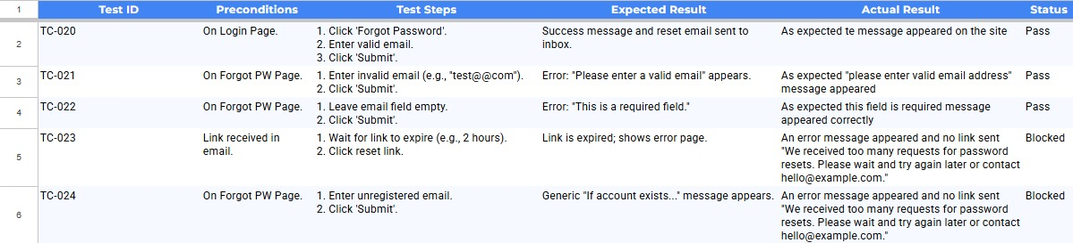
Test Cases
Sample Test Cases A sample of the manual testing performed on the Magento 2 Demo e-commerce site — illustrating our approach, expected outcomes, actual results, and execution status.
Manual Testing · Forgot Password module · Magento 2 Demo

Slide 7
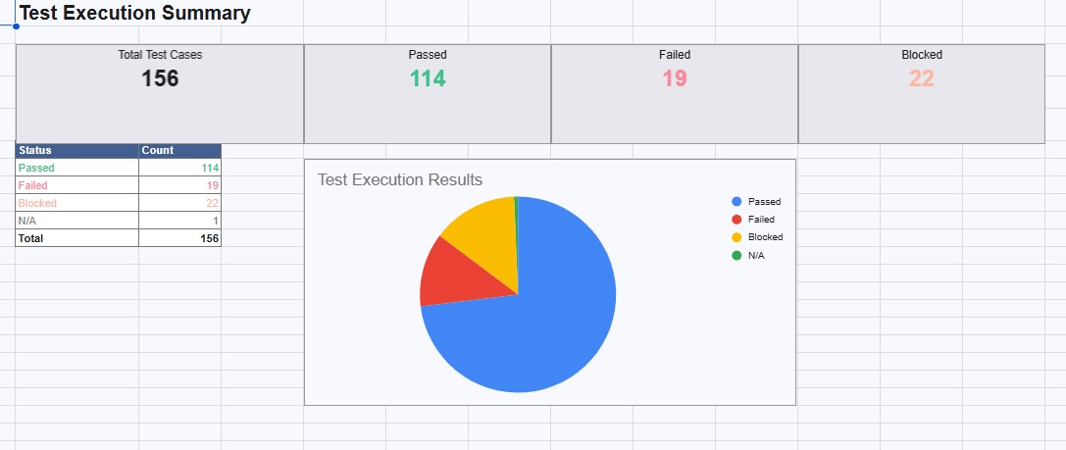
Test Execution Summary
Execution Overview
The summary below presents the results of the manual testing phase — the total executed test cases and their distribution across Passed, Failed, and Blocked outcomes, giving a clear view of overall coverage and status.

Slide 8
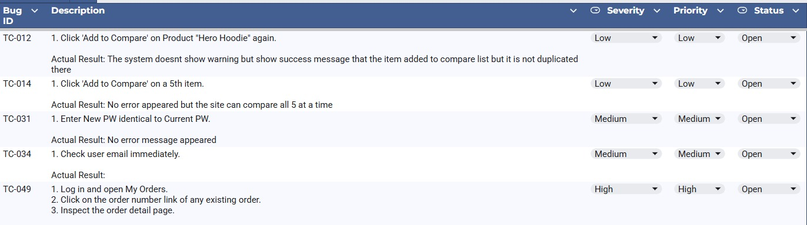
Bug Report
Bug Overview
A selection of defects identified during the manual testing phase — each documented, analyzed, and classified by severity and status to support effective tracking and resolution.
Manual Testing · Defect Log · Magento 2 Demo

Slide 9



Tools Used
Tools & Technologies
The following tools were used throughout the project to perform Manual, Automation, and API Testing.
Microsoft Excel
Selenium WebDriver
Postman
Manual Testing Documentation
Automation Testing
API Testing

Slide 10



Challenges & Solutions
Challenge
Solutions
The initial site (Magento 2 Demo) suited Manual Testing, but during the Automation and API phases it lacked the functionality and product availability needed for the planned scenarios — so we had to revise our approach and choose a more suitable platform.
Switched from Magento 2 Demo to Expand Testing to complete the Automation & API Testing phases.
Used more reliable, stable Selenium locators to improve test stability and execution.
Reviewed the API documentation and refined requests for accurate validation and successful testing.
Biggest Challenge
The biggest challenge was adapting the test plan after discovering the first website's limitations. By selecting a more suitable platform and refining our approach, we successfully completed all project objectives.

Slide 11



Conclusion
Project Conclusion
Future Improvements
The project was completed successfully, with all planned objectives achieved. Manual, Automation, and API Testing evaluated the quality and functionality of the selected web applications.
▸ Expand Automation Testing coverage.
▸ Perform Performance Testing.
▸ Conduct Security Testing.
▸ Increase API test coverage for additional scenarios.
Core features verified
Defects identified and documented
Functional requirements confirmed
Application ready for release

Slide 12
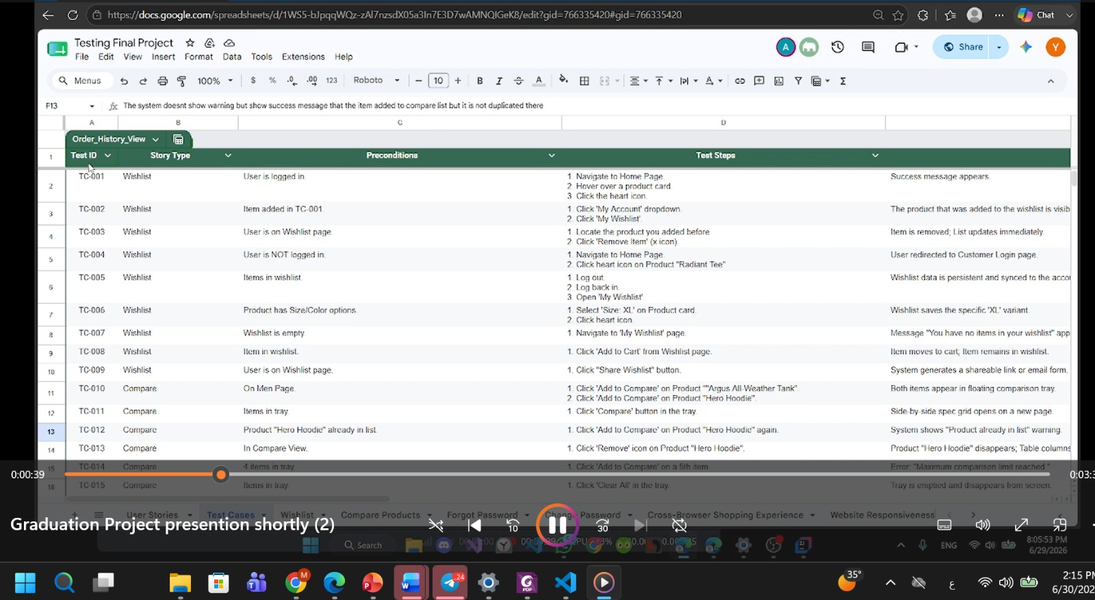
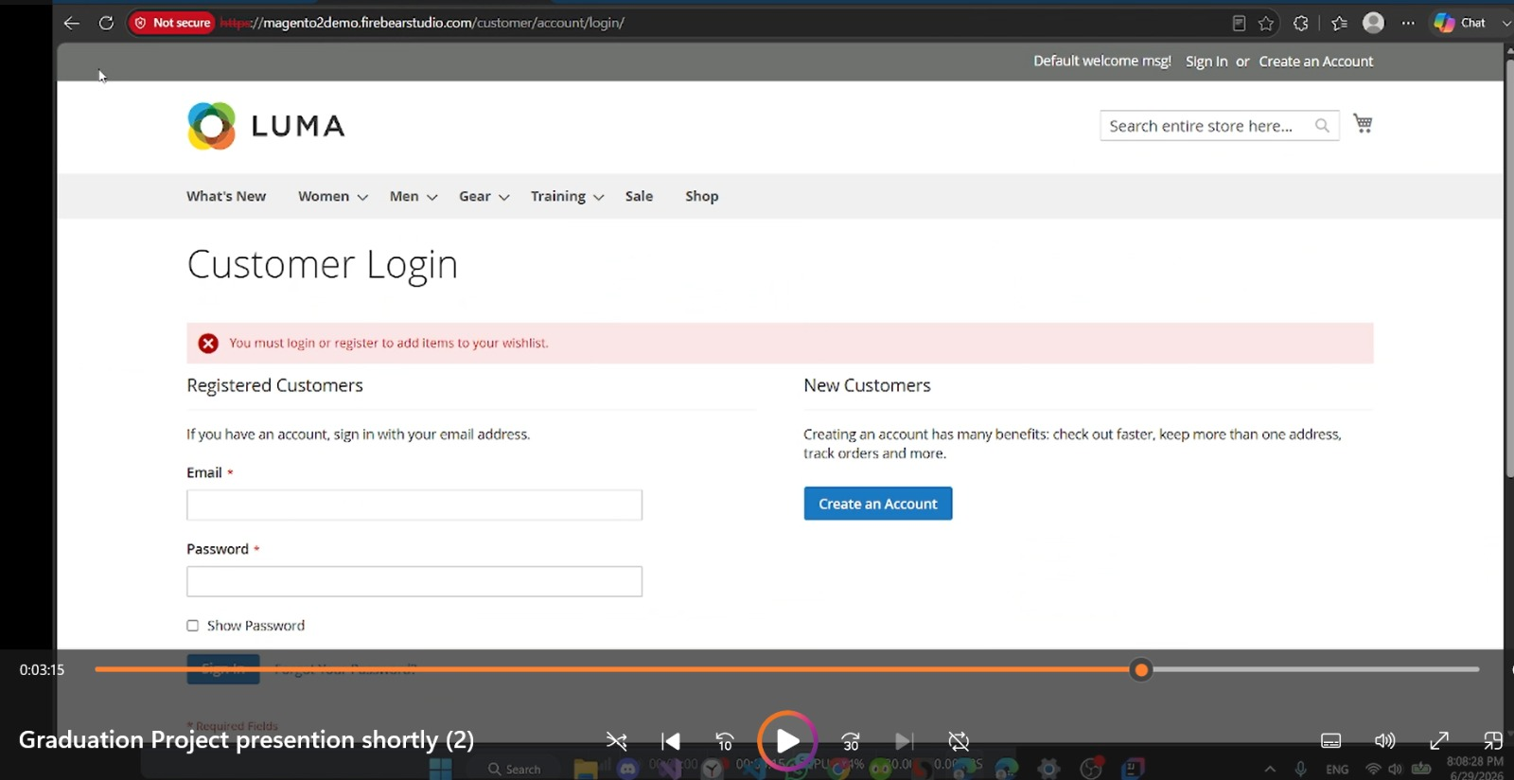

Demo Video
Project Demonstration
The demo showcases the manual testing process on the Magento 2 Demo e-commerce site — executing test cases, validating core functionality, and documenting results to highlight the project's practical implementation.
Test Case Execution · Google Sheets
Magento 2 Demo · Customer Login

Slide 13


Thank You!
Thank you for your time, attention, and valuable evaluation.
We sincerely appreciate the opportunity to present our Software Testing project, and hope our work reflects our technical knowledge, teamwork, and commitment to software quality.
Questions?
We would be delighted to answer any questions.

